Slide 1
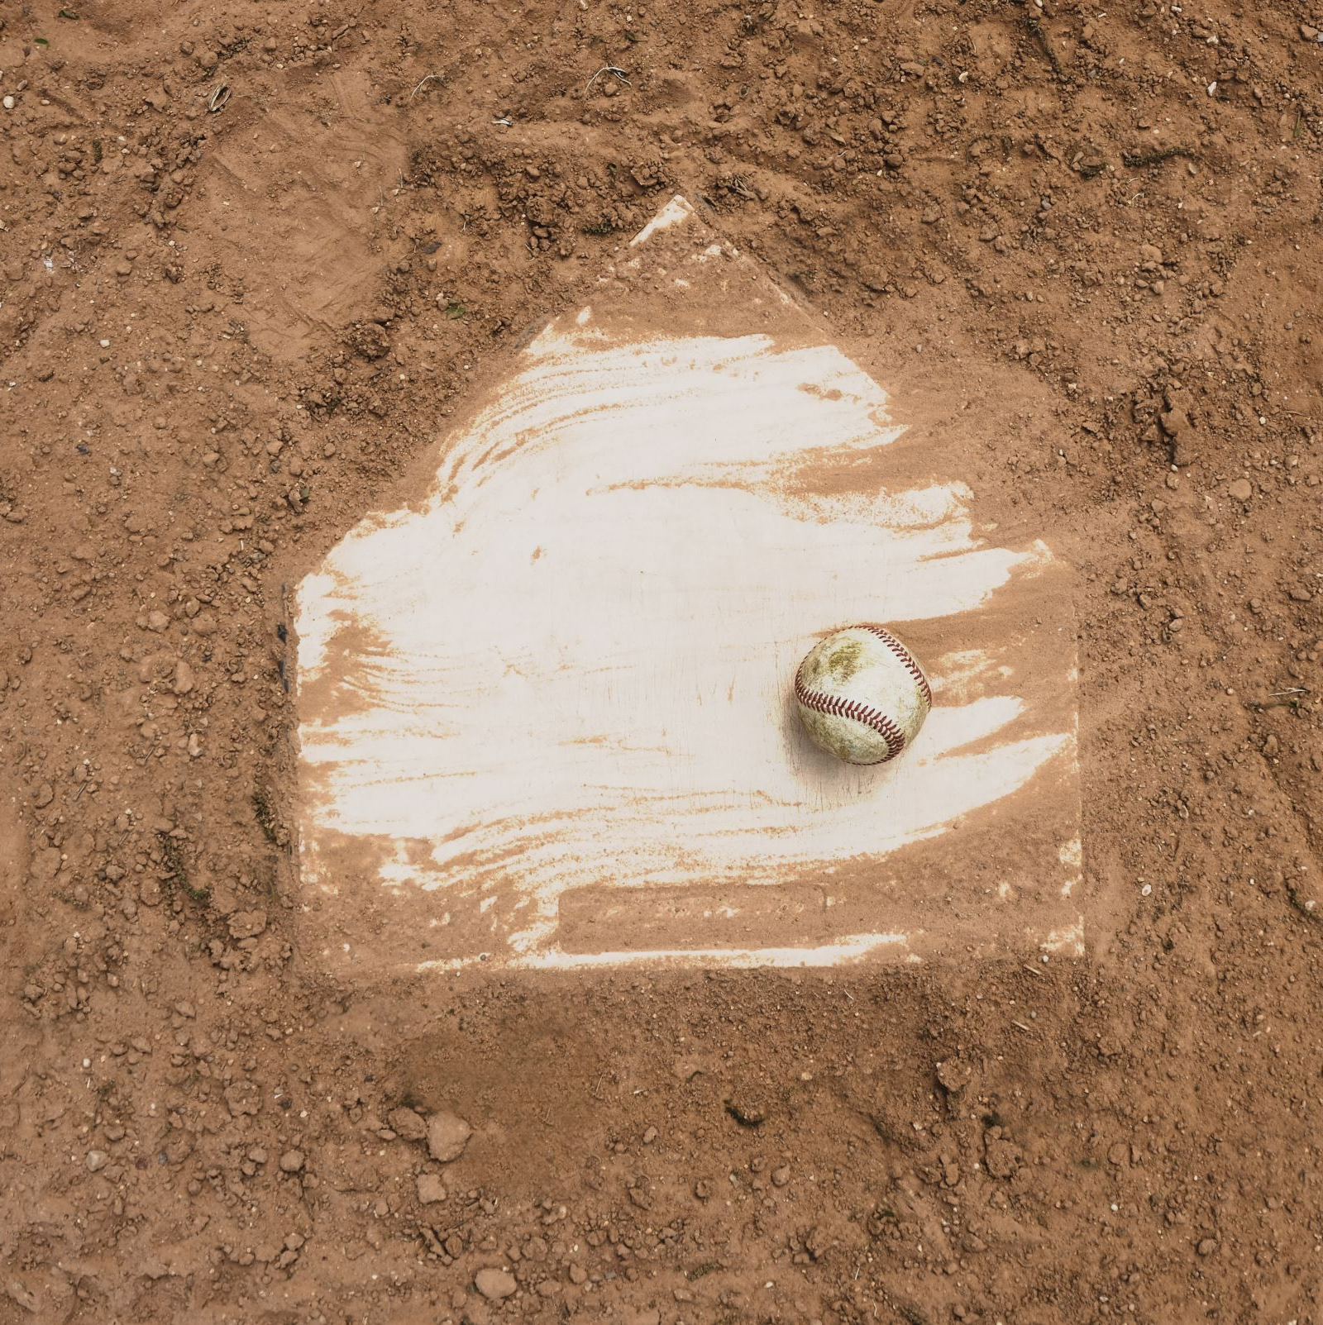
Project 1: Baseball Analysis
Josh Urry

Slide 2
4 Analyses
How does the average strikeouts by pitchers change over time?
Does pitching hand have an effect?
What players have the highest strikeouts in a season?
What about average strikeouts over their career?
Do lighter players steal bases more often than heavier players?
Do heavier players get caught stealing more often than lighter players?
Which teams pay players the most?
Do teams that pay their players more have more wins?

Slide 3
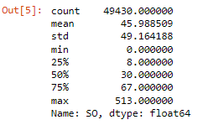
1: How do strikeouts change over time?

Slide 4
1: Does throwing hand affect strikeout averages?
Left-handed avg: 45.8
Right-handed avg: 46.1
t = 1.05, p = 0.29

Slide 5
2: What players have the highest strike out count in a season?

Slide 6


3: Do lighter players steal more bases than heavier players?
r = -0.13, p = 5.27 $e^{−9}$
r = -0.27, p = 3.09 $e^{−22}$

Slide 7
4: What teams pay players the most?

Slide 8

Do higher salaries mean more wins?
t = 1.35, p = 0.18
t = 5.29, p = 1.3 $e^{−7}$

